Slide 1
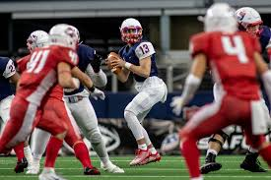
BEST PLACE TO WATCH MORE FOOTBALL GAMES IN usa
COURSERA GOPI 052320 10AM

Slide 2
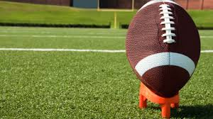
Business Problem
Football fan in France, never visited USA, but would like to visit and stay in a city in USA for a month to watch more football matches, without traveling to many cities in USA. The problem is to analyze the density of Football stadium in the major US cities and find the best place for our tourist so that he can visit one place, stay and watch all matches without traveling to multiple places
COURSERA GOPI 052320 10AM

Slide 3
DATA SECTION
FourSquare API is used to collect data about locations of Football stadium in 5 major US cities which are: New York,NY, San Francisco, CA, Jersey City, NJ, Boston, MA and Chicago,IL. These are one of the most famous US cities. Our tourist can visit one of these places, enjoy more football along with visiting the attractions close by
COURSERA GOPI 052320 10AM

Slide 4
Methodology
First I assessed city would have the highest football stadium density. I used the Four Square API through the venues channel. I used the near query to get venues in the cities. I used the CategoryID to set it to show only football stadium
To get an indicator of the density of football stadium, I calculated a center coordinate of the venues to get the mean longitude and latitude values.
Then I calculated the mean of the Euclidean distance from each venue to the mean coordinates. That was my indicator; mean distance to the mean coordinate.
COURSERA GOPI 052320 10AM

Slide 5
Results
Upon our inspection we see that San Francisco, New York and Jersey City and are the most densely cities, then calculated the Mean coordinate and the mean distance to mean coordinate(MDMC). Below represent mean coordinate with a big green circle and distances with green lines
COURSERA GOPI 052320 10AM

Slide 6
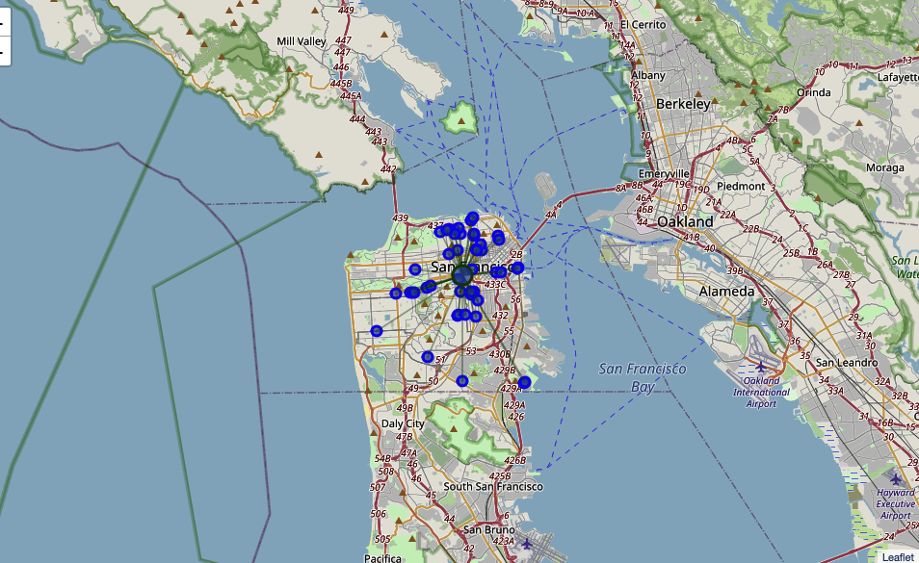
Sanfransico
COURSERA GOPI 052320 10AM
COURSERA GOPI 052320 10AM

Slide 7
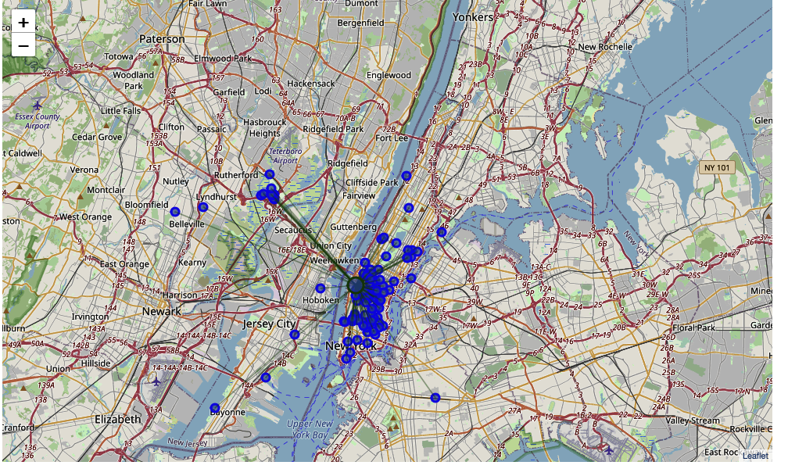
Newyork
COURSERA GOPI 052320 10AM

Slide 8
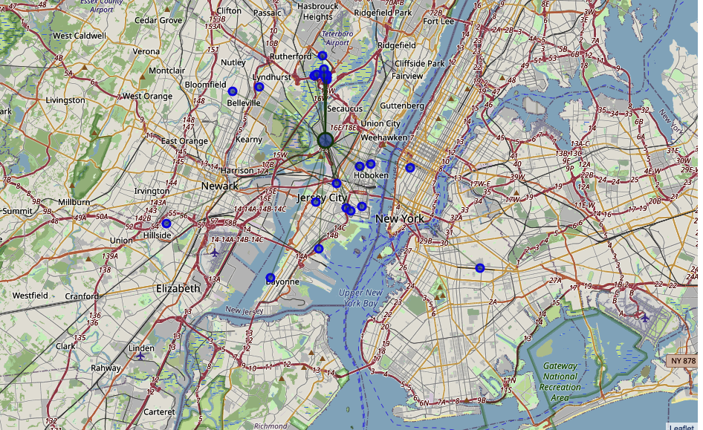
Jersey city
COURSERA GOPI 052320 10AM

Slide 9
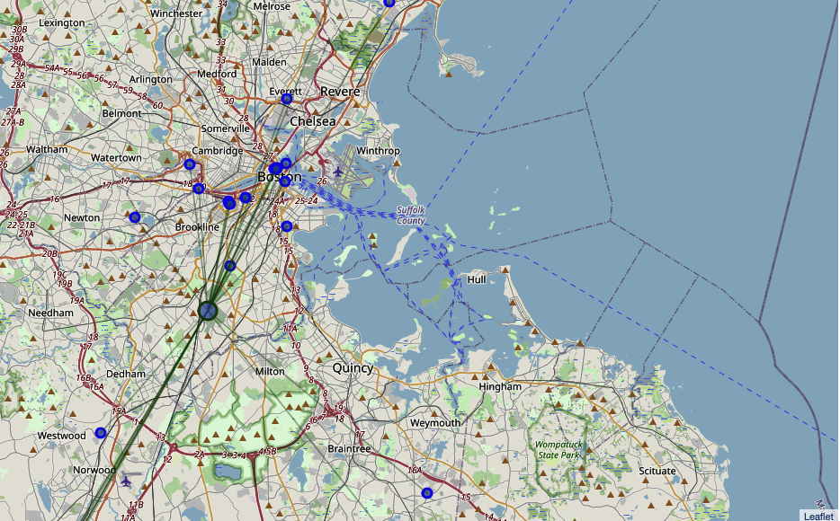
Boston
COURSERA GOPI 052320 10AM

Slide 10
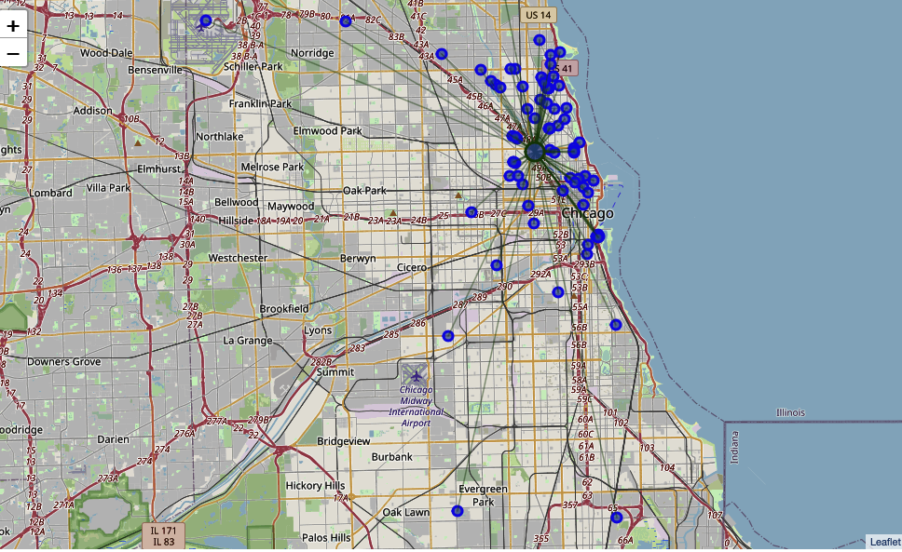
chicago
COURSERA GOPI 052320 10AM

Slide 11
Conclusion
With all our analysis, we are concluding that San Francisco is the best place for our tourist to watch more football games in USA than any other city in USA, it will help our tourist save cost and time in avoiding travel to multiple places to watch his most loved football games in USA, just in staying in San Francisco, he can other attractions in San Francisco while there was no football match.
COURSERA GOPI 052320 10AM

